Slide 1

CREDIT CARD FRAUD DETECTION

Slide 2
PROJECT DESCRIPTION :
Data source
Data preparation
Data preprocessing
Data modeling
Evaluation and Deployment

Slide 3
What is credit card fraud detection?
Credit card fraud is an inclusive term for fraud committed using a payment card, such as a credit card or debit card. The purpose may be to obtain goods or services or to make payment to another account, which is controlled by a criminal. The Payment Card Industry Data Security Standard (PCI DSS) is the data security standard created to help financial institutions process card payments securely and reduce card fraud.

Slide 4
Data Source:
The dataset was retrieved from an open-source website, Kaggle.com.
It contains data of transactions that were made in 2013 by credit card users in Europe, in two days only.
The dataset consists of 31 attributes, 284,808 rows.
Dataset Link:
https://www.kaggle.com/datasets/mlg-ulb/creditcardfraud

Slide 5
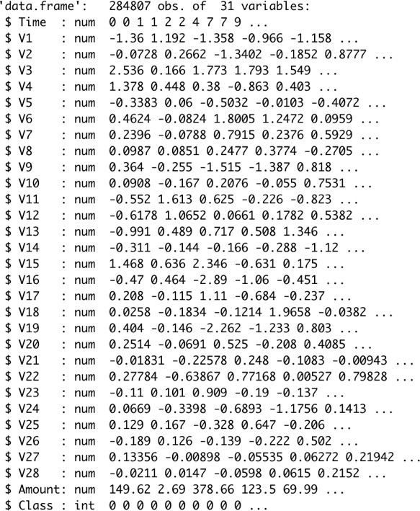
Data Preparation:
The figure shows the structure of the dataset where all attributes are shown, with their type, in addition to glimpse of the variables within each attribute, as shown at the end of the figure the Class type is integer which I needed to change to factor and identify the 0 as Not Fraud and the 1 as Fraud to ease the process of creating the model and obtain visualizations

Slide 6
Data Preprocessing :
As there are no NAs nor duplicated variables, the preparation of the dataset was simple the first alteration that was made to be able to open the dataset on Weka program is changing the type of the class attribute from Numeric to Class and identify the class as {1,0} using the program Sublime Text. Another alteration was made on the type as well on the R program to be able to create the model and the visualization.
The 4.3 Data ModelingAfter making sure that the data is ready to get modeled the four models were created using both Weka and R. the model SVM was created using Weka only, as for KNN, Logistic Regression and NaïveBayes they were created using R and Weka.

Slide 7
Evaluation and Deployment:
Table 1 - Confusion Matrix
The last stage of the CRISP-DM model is the evaluation and deployment stage, as presented in table 2 below all models are being compared to each other to figure the best model in identifying fraudulent credit card transactions.
Accuracy is the overall number of instances that are predicted correctly, accuracies are represented by confusion matrix where it showed the True Positive (TP), True Negative (TN), False Positive (FP) and False Negative (FN).
Actual/Predicted | Positie | Negatie
Positive | TP | FN
Negative | FP | TN

Slide 8
Conclusion:
In conclusion, the main objective of this project was to find the most suited model in creditcard fraud detection in terms of the machine learning techniques chosen for the project, and it was met by building the four models and finding the accuracies of them all, the best model in terms of accuracies is Support Vector Machine which scored 99.94% with only 51 misclassified instances

